Slide 1

Image Scraping And Classification Project

Slide 2
Introduction
Images are one of the major sources of data in the field of data science and AI. This field is making appropriate use of information that can be gathered through images by examining its features and details. We are trying to give an exposure of how an end to end project is developed in this field.
The idea behind this project is to build a deep learning-based Image Classification model on images that will be scraped from e-commerce portal. This is done to make the model more and more robust.
The Project consists of two phases:
1. Data Collection Phase
2. Model Building Phase

Slide 3
Data Collection Phase
We have to scrape images from e-commerce portal, Amazon.in.
The clothing categories used for scraping are:
Sarees (women)
Trousers (men)
Jeans (men)
First we have scraped link of those images using Selenium framework and then created directories to download and save scraped images.
The categories are defined as Jeans, Sarees, Trousers.
We have scraped 680 images for each category i.e. total of 2040 images is collected and created a directory to download images.

Slide 4
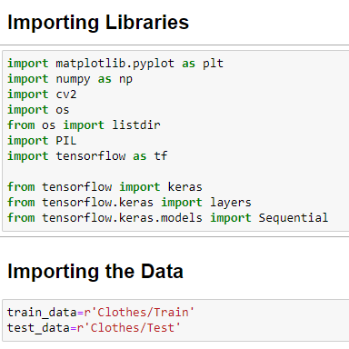

Slide 5
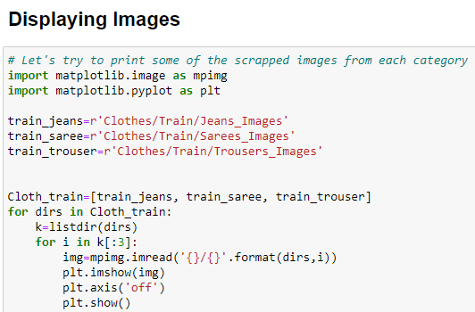
Displaying The Images

Slide 6
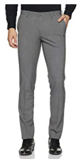
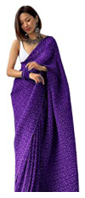
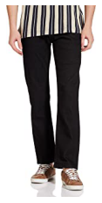
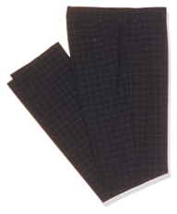
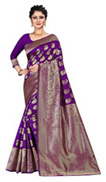

Displaying The Scraped Images
Trousers Sarees Jeans

Slide 7
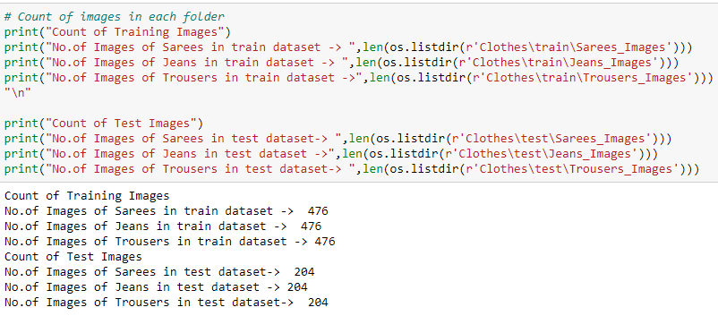
Count Of Images In Each Folder

Slide 8
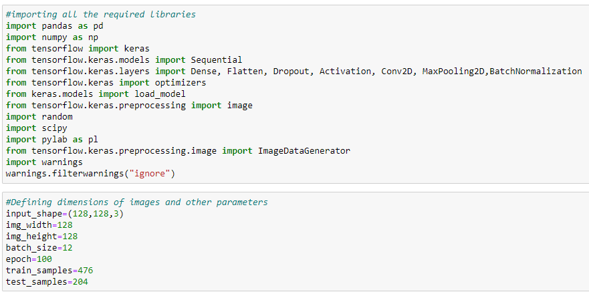
Model Building Phase
After the data collection and preparation is done, We have build an image classification model that will classify between these 3 categories mentioned above.
First we will be defining dimensions of images and other parameters too. Then for data augmentation we defined training and testing set.

Slide 9
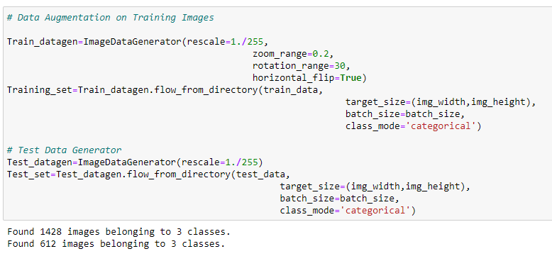
Data Augmentation

Slide 10
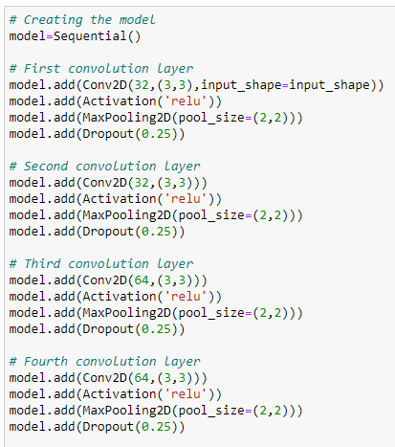
Created A Model Using Convolution Neural Network

Slide 11
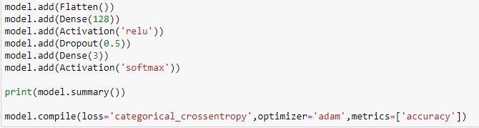
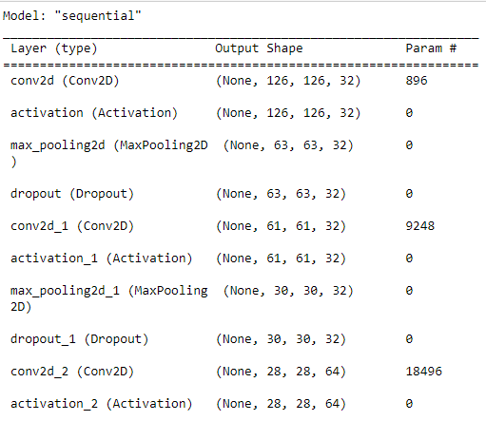

Slide 12
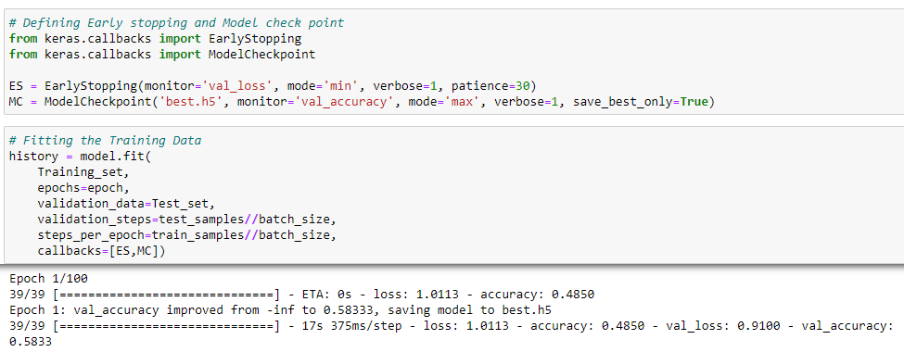
Define early stop criteria
and model check point

Slide 13
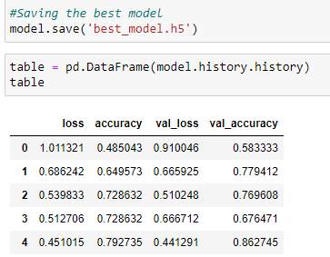
Saving the Model

Slide 14
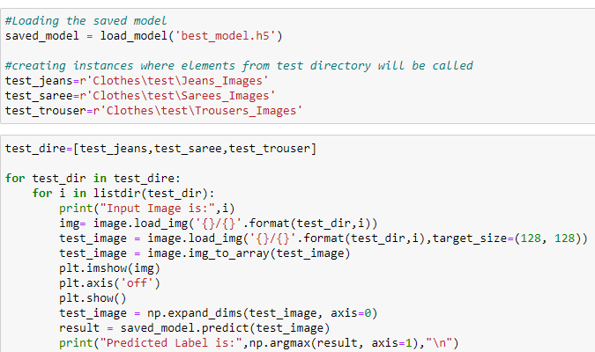
Prediction

Slide 15
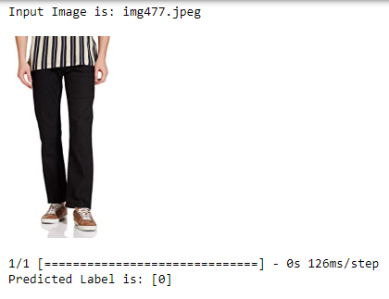
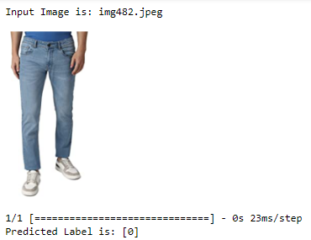
Prediction Results
JEANS IMAGES

Slide 16
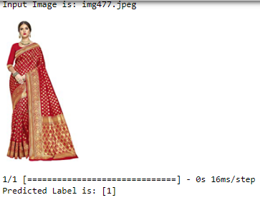
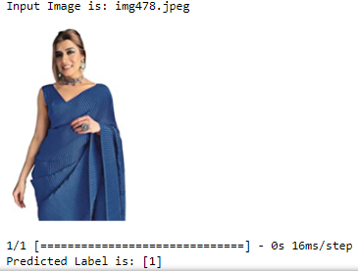
SAREE IMAGES

Slide 17
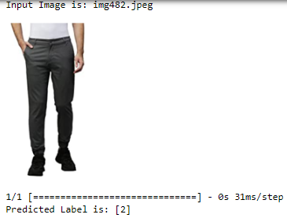
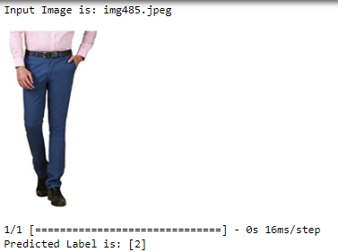
TROUSER IMAGES

Slide 18
Conclusion
KEY FINDINGS AND CONCLUSIONS OF THE STUDY:
In conclusion, this project is about image classification by using deep learning via framework Tensor-Flow. The roles of epochs in CNN was able to control accuracy and also prevent any problems such as overfitting. Thus we were able to classify the three categories of images with an accuracy of 86.4%.
LEARNING OUTCOMES OF THE STUDY IN RESPECT OF DATA SCIENCE:
In this project we were able to learn about Deep Neural Networks and Convolution Neural Network. We also learned techniques to scrap and download images in the specified directory using code.

Slide 19
LO AND SCOPE FOR FUTURE WORK
Limitations of this Work and Scope for Future Work
While we couldn’t reach out goal of 100% accuracy in image classification, we did end up creating a system that can with enough time and data get very close to that goal. As with any project there is room for improvement here.
This model can further be improved with the addition of more algorithms into it. However, the output of these algorithms needs to be in the same format as the others.
Once that condition is satisfied, the modules are easy to add as done in the code. This provides a great degree of modularity and versatility to the project.

Slide 20
THANK YOU
Prepared by: Archana Kumari
SME Name: Shwetank Mishra

